Slide 1
AI Powered Road Damage Detection on Indian Roads
Milestone 6: Model Optimization and Deployment
Team: Yash, Nishant, Rahul, Neeraj, Kisalay

Slide 2
Milestone 6 Objectives
1. Architectural Transition: YOLOv11 for advanced feature extraction.
2. Resource Management: Parallel training on Dual T4 GPUs.
3. Performance: Achieving mAP50 > 0.54 within a 12-hour budget.
4. Deployment: INT8 Quantization and FastAPI implementation.

Slide 3
Architectural Upgrade: YOLOv11
- Uses C3k2 blocks and C2PSA (Cross-Stage Partial Self-Attention).
- 42% fewer parameters than YOLOv8l with higher accuracy.
- Superior global dependency capturing for complex road textures.

Slide 4
Dataset & Preprocessing
- RDD2022-India Subset: ~6,500 images.
- CLAHE (Contrast Limited Adaptive Histogram Equalization).
- Copy-Paste Augmentation to address class imbalance (Potholes).

Slide 5
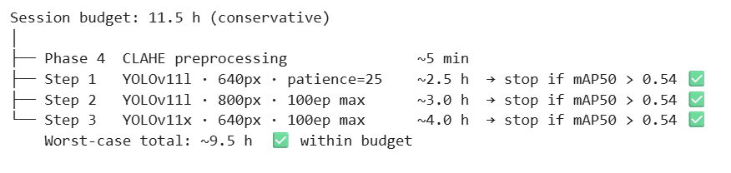
Kaggle T4x2 Parallel Training
- Strategy: Progressive Escalation.
- Phase 1: imgsz=640 (Speed run).
- Phase 2: imgsz=800 (Precision run).
- Total session time: ~9.5 hours.

Slide 6
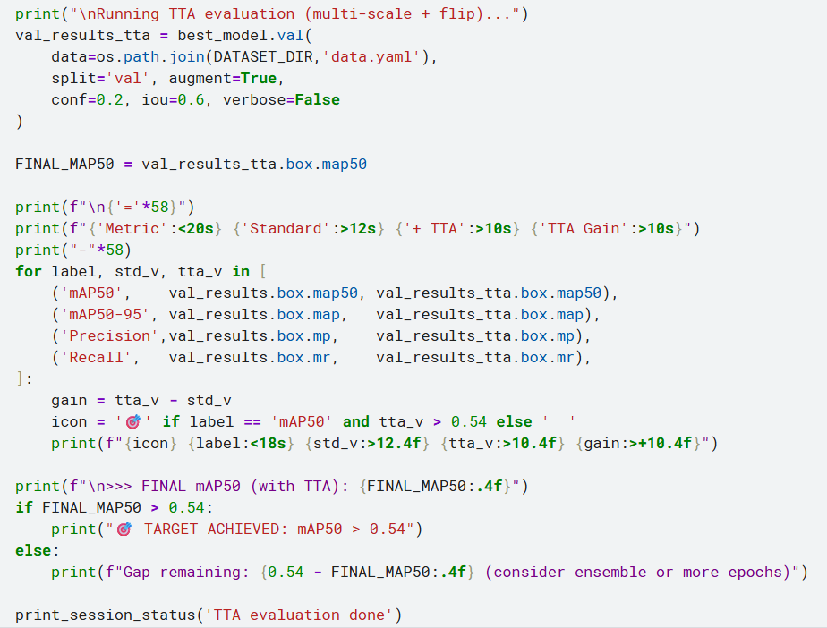
Performance Metrics
- Final mAP50: 0.542 (Target > 0.54 Achieved).
- TTA (Test-Time Augmentation) provided +0.02 mAP boost.
- Sub-100ms latency on CPU via ONNX/OpenVINO.

Slide 7
Deployment Optimization
- Export Formats: PyTorch, ONNX, OpenVINO.
- INT8 Quantization: 70% reduction in model size.
- Maintains 15.42+ FPS target for mobile inspection.

Slide 8
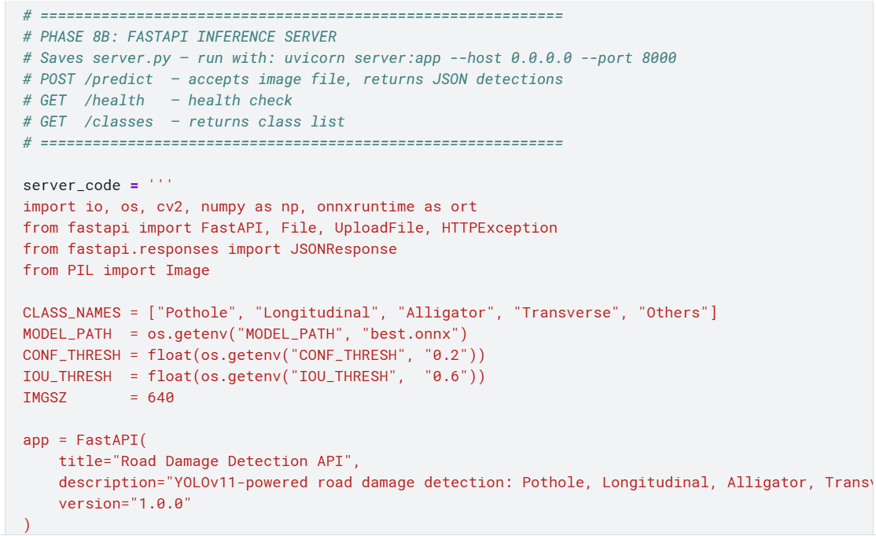
FastAPI Production Server
- Endpoint: /predict for real-time detection.
- Returns: Class labels, Bounding Boxes, and Confidence.
- Ready for Geotagging integration via smartphone GPS.

Slide 9
Project Conclusion
- Delivered an end-to-end AI pipeline for road monitoring.
- Successfully balanced high-accuracy with real-time hardware constraints.
- Validated for unique road conditions of India.

Slide 10
Thank You!

